Slide 1
A Case for a Risk-Based Sampling Approach to Manual Accessibility Testing
Download this presentation at iAccesible.com
Lead Author: Mark Turner, Ph.D. (Principal Research Associate)
Contributing Author: Arthak Adhikari (Research Analyst)

Slide 2
About Me: Mark Turner, Ph.D.
Ph.D. economist and data scientist
25+ years experience leading national/international research, building software and analytics products
Previously worked at GAO, Urban Institute, Johns Hopkins University, Georgetown University
Boards: UMCP College Board of Visitors, UMCP Economic Leadership Council
Hobbies: kayaking, boating, and biking

Slide 3
Our Team
Optimal Solutions Group policy research and evaluation firm located at UMCP Discovery District, founded in 2000.
Revelo Software spun-off in 2019
Team includes designers, developers, UI/UX, data scientists, accessibility professionals with additional expertise from the UMD Trace Research and Development Center
Revelo is a data management platform that provides augmented analytics
Augmented data preparation features allow users with average skills to perform data preparation and transform, shape, reduce, combine, explore, clean, sample and aggregate data, without the need for SQL skills, ETL or other programming language.

Slide 4
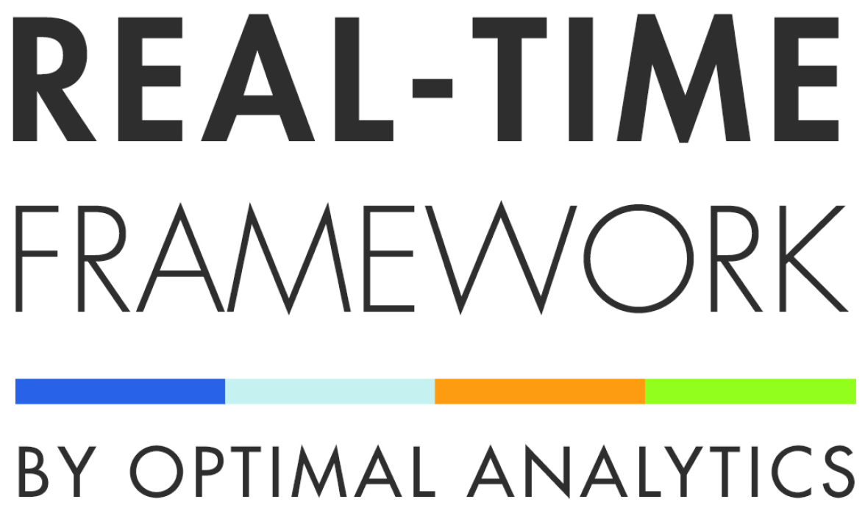
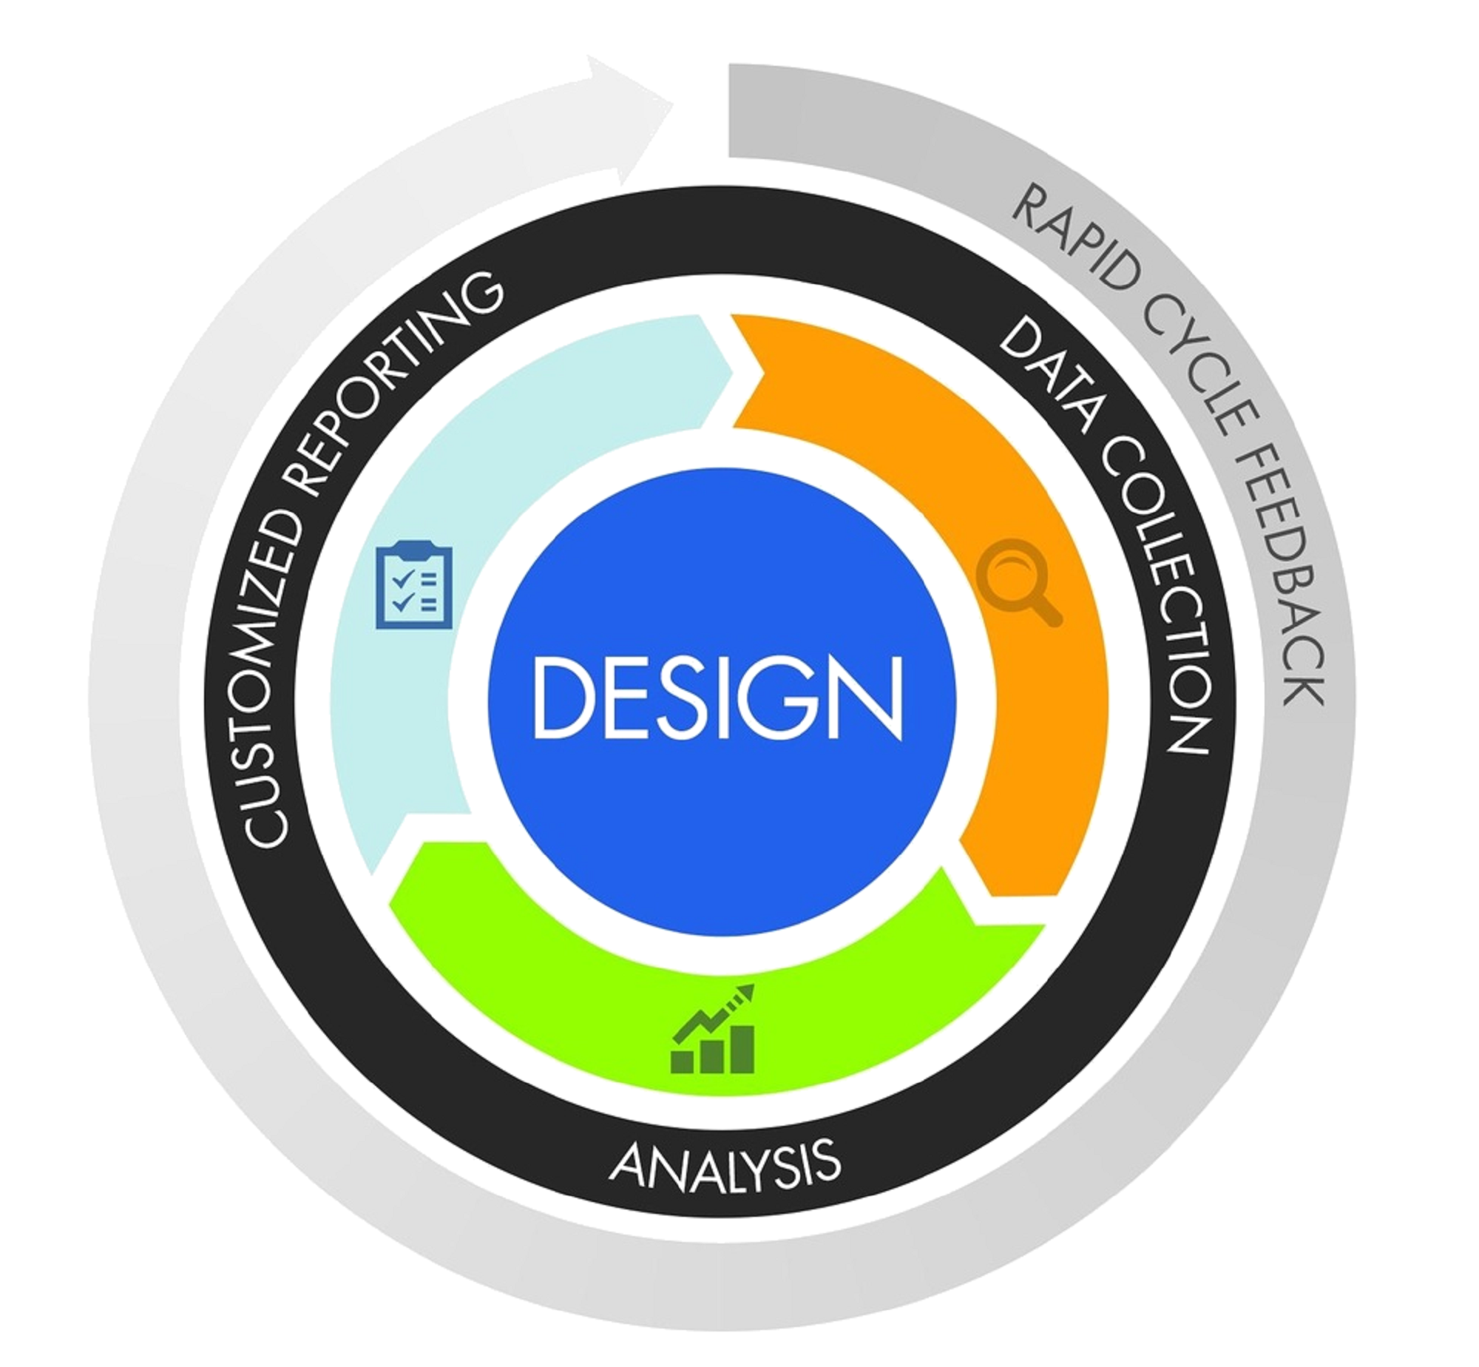
Real-Time Framework Image

Slide 5
Tools Powered By Revelo
e-508.com

Slide 6
iAccessible Logo

Slide 7
What is iAccessible?
iAcccessible is an automated tool to aid your organization in meeting digital content accessibility compliance under the Americans with Disabilities Act (ADA) and Section 508 by scanning your digital content for compliance measures outlined in the Web Content Accessibility Guidelines (WCAG) while provided resources needed for remediation.

Slide 8
Agenda
Overview of Sampling
Simple random sampling
Stratified sampling
Approach
Next steps

Slide 9
Abstract
Automated testing can only assess 30 to 35% of WCAG requirements
Manual testing is required to ensure full compliance with WCAG standards
However, manually testing the universe of web-pages for a website would be labor intensive and cost prohibitive
We propose a risk-based sampling approach that would lower costs while still providing valuable insights into the accessibility of an entire website

Slide 10
Why Sample?

Slide 11
Simple Random Sampling
Observations are selected from a population so that each observation has same probability of being selected for the sample
Sampling is stopped when total desired sample size is reached
Depending on whether the sampling approach is with or without replacement, once an observation is selected it may or may not be eligible to be selected again

Slide 12
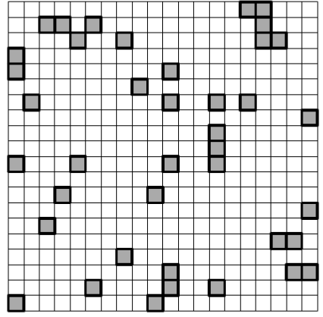
Example of Simple Random Sampling

Slide 13
Stratified Sampling
Population of interest is divided into groups or strata
The observations within a particular stratum are similar to the other observations within the same stratum
Samples are drawn from each stratum until desired sample size is reached
Stratified sampling can be proportional or disproportional

Slide 14
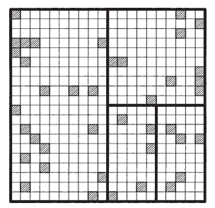
Example of Stratified Sampling

Slide 15
Stratified or Simple Random Sampling?
In the case of testing a website for accessibility issues, then a stratified sampling approach is preferred
Web-pages of a website differ in characteristics such as; amount of user traffic, frequency of change, structure, etc.
A random sampling approach would not take this into consideration
Stratified sampling allows the creation of strata based on web-page characteristics and allows disproportional sampling of web-pages deemed to have higher accessibility risk

Slide 16
Approach
Assess the universe
Potential strata:
Webpage layout / structure
Volume of user traffic
Frequency and intensity of changes
Other?
Select level of confidence

Slide 17
Tradeoffs
Cons:
Uncertainty
Pros:
Measurable
Reliable
Realistic and Timeliness
Scalable

Slide 18
Next Steps

